Slide 1
Methods
Determination of molecular weight distribution with SEC MALS
Size-exclusion chromatography (SEC) with online multi-angle static laser light scattering (MALS) were performed at ambient temperature on an Agilent 1260 Infinity II system consisting of a solvent reservoir, isocratic pump, automatic sample injector, pre-column (OHpak LB-G 6B guard) and a main column (OHpak LB 806M). The column outlet was connected to a Dawn HELEOS-II multi-angle laser light scattering photometer (Wyatt, U.S.A.) (λ₀=663.8 nm) followed by RI-501 refractive index detector (Shodex). ​
The eluent was 0.15 M NaNO₃ with 0.01 M EDTA (pH = 6.0) and the flow rate was 0.5 mL/min. The samples were dissolved in mobile phase (c = 0.5 mg/mL) over night and filtered (pore size 0.45 μm) before injection. The injection volume was 50 and 100 µL.
Data were collected and processed using Astra (version 7.3.21) software (Wyatt, USA).​
dn/dc = 0.150 mL/g and A₂=2.0 x 10⁻⁴ ml*mol g² for Xanthan

Slide 2
Results
Table 2 Molecular weights and polydispersity determined by SEC-MALS. All inj.
File name | sample | Mn (kDa) | Mw (kDa) | PI (Mw/Mn) | rw (nm) | Inj. mass (µg) | Mass recovery (%)
DkA003[260323] | ΔkA | 433.1 | 683.1 | 1.6 | 32.5 | 50 | 39.3
DkA011[260323] | ΔkA | 411.2 | 670.6 | 1.6 | 32.1 | 25 | 39.6
DkA018[260323] | ΔkA | 441.2 | 680 | 1.5 | 32.5 | 25 | 39
DIA005[260323] | ΔIA | 463.1 | 613.2 | 1.3 | 39 | 50 | 69.6
DIA013[260323] | ΔIA | 467.8 | 619.5 | 1.3 | 39 | 25 | 69.7
DIA020[260323] | ΔIA | 454.3 | 606.1 | 1.3 | 38.9 | 25 | 71.4
DkB004[260323] | ΔkB | 564.3 | 891.9 | 1.6 | 28.1 | 50 | 44.3
DkB012[260323] | ΔkB | 517 | 830.1 | 1.6 | 28.6 | 25 | 46.7
DkB019[260323] | ΔkB | 523 | 837.5 | 1.6 | 28.2 | 25 | 45.8
DIB006[260323] | ΔIB | 246.2 | 514.7 | 2.1 | 30.4 | 50 | 76.6
DIB014[260323] | ΔIB | 248.3 | 524.6 | 2.1 | 30.3 | 25 | 76.4
DIB021[260323] | ΔIB | 249.4 | 528.6 | 2.1 | 30.6 | 25 | 77
WT007[260323] | WT | 860.2 | 1100.1 | 1.3 | 59.9 | 50 | 68.8
WT015[260323] | WT | 858.2 | 1095.5 | 1.3 | 60.1 | 25 | 68.9
WT022[260323] | WT | 853.3 | 1095.3 | 1.3 | 60.1 | 25 | 68.9
WTB008[260323] | WTB | 1018.8 | 1338.4 | 1.3 | 68.5 | 50 | 58
WTB016[260323] | WTB | 1043.8 | 1351.5 | 1.3 | 69.2 | 25 | 57.6
WTB023[260323] | WTB | 1027.6 | 1338.2 | 1.3 | 69.2 | 25 | 58.1
P137002[260323] |  | 120.3 | 133.1 | 1.1 |  | 100 | 91.7
P137010[260323] |  | 120.7 | 133.7 | 1.1 |  | 50 | 91.7

Slide 3
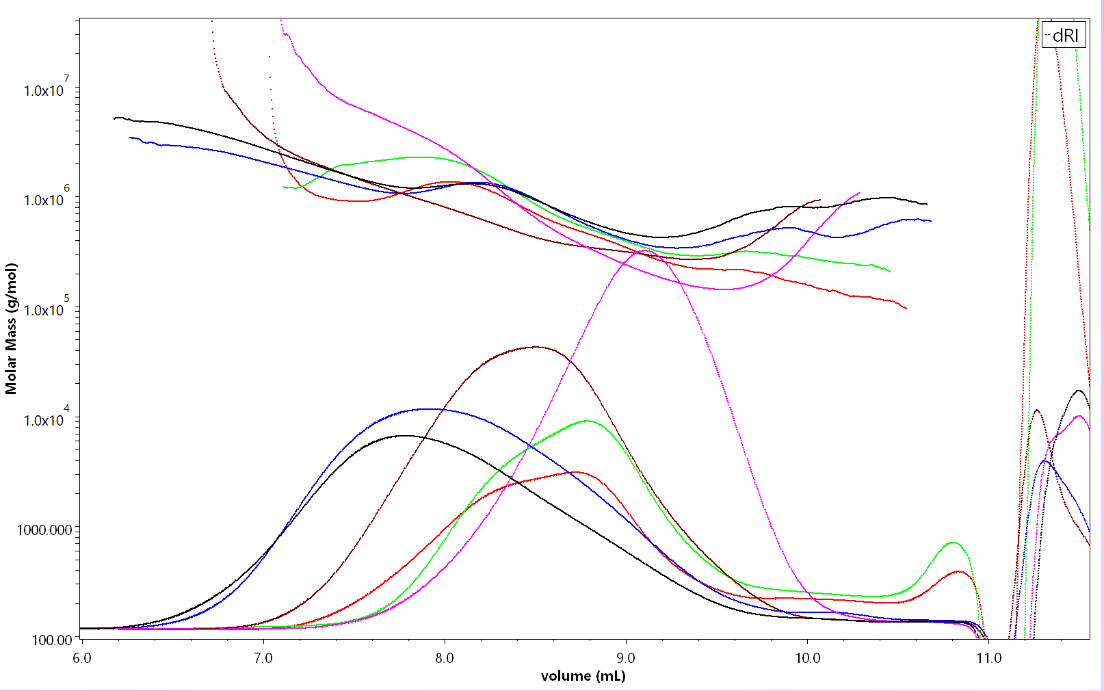
Figure 1: Refractive index chromatograms with overlaid Vol-Mw curve for Xanthan samples. 25µg of each

Slide 4
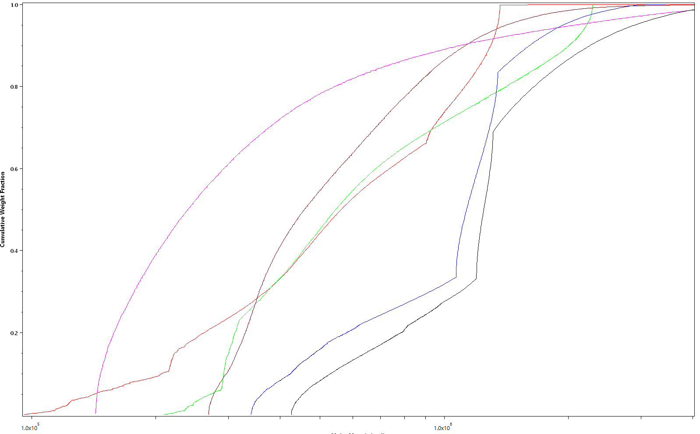
Figure 1: Cummulative weight distributions for Xanthan samples. 25µg of each

Slide 5
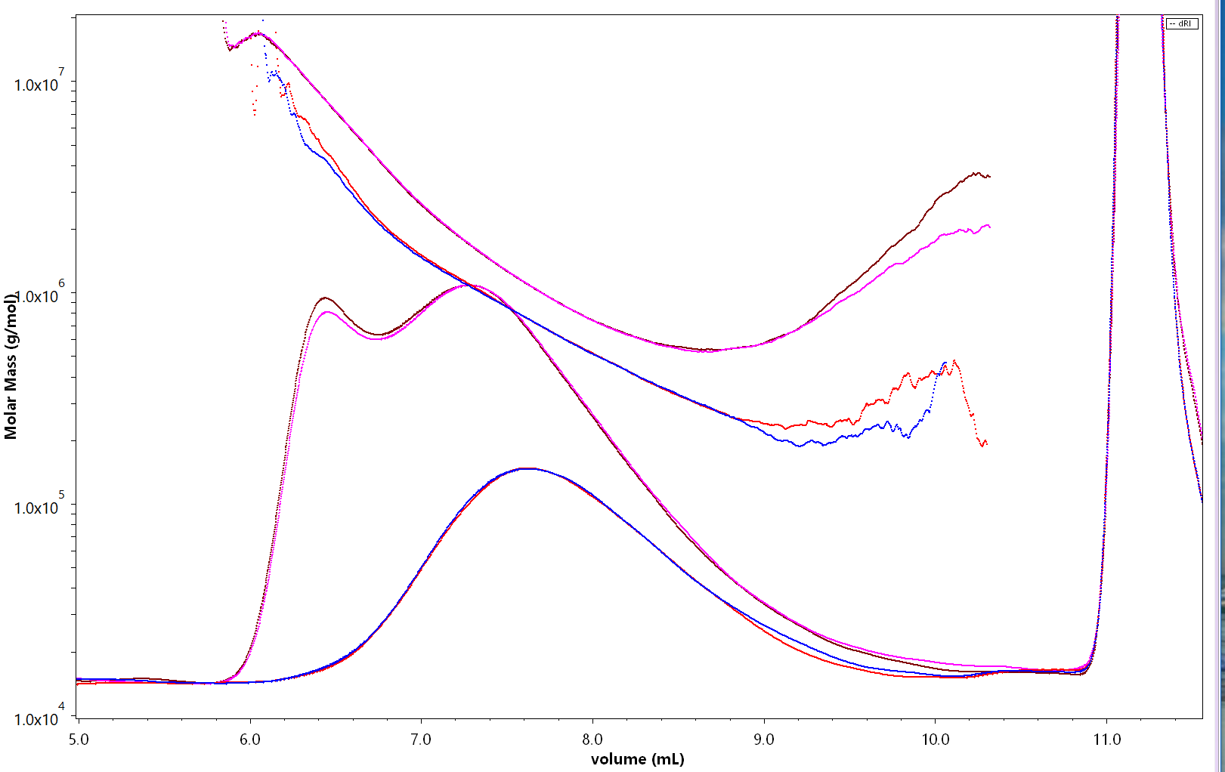
Alginat standsard sonikert 60 min
Prøve | Mn (kDa) | Mw (kDa) | PI (Mw/Mn) | rw (nm) | Inj. mass (µg) | Mass rec.(%)
Xanthan løst i MQ | 1265.5 | 3041.2 | 2.4 | 175.7 | 50 | 43.5
Xanthan løst i MQ | 1323.7 | 3277 | 2.5 | 186 | 25 | 45.3
Xanthan løst i MQ | 1295.4 | 3183.1 | 2.5 | 182.2 | 25 | 45.2
Xanthan løst i mobilfase | 515.6 | 791.5 | 1.5 | 93.5 | 50 | 18.7
Xanthan løst i mobilfase | 537.8 | 811 | 1.5 | 94.9 | 25 | 18.5
Xanthan løst i mobilfase | 513.1 | 791 | 1.5 | 93.7 | 25 | 18.9
*
Dette var bekymringsfullt. Er det behov for en protokoll og sammenlikning av ulike måter å løse prøven på?
Må ta et lite forbehold om labfeil, vekt etc, men tror ikke det. Jeg merket at prøven løst direkte i mobilfase var tyngre å filtrere. Begge stod sikkert 18 timer på karusell.
MQ
Mob phase
Figure 1: Refractive index chromatograms with overlaid Vol-Mw curve for Xanthan 60 min sonicated anddissolved in ion free water (10mg/ml over night, then diluted with 2x mob phase and finally diluted to 0.5 mg/ml with 1x mobile phase. Compared to the same sample dissolved directly to 0.5mg/ml with 1x mobile phase over night

